Slide 1
Email Spam Detector
Overview of detection methods and model deployment for robust spam filtering.

Slide 2
Introduction
Email spam consists of unwanted or fraudulent messages sent to users. These emails may contain advertisements, phishing links, or malware. Since manually filtering spam is difficult, machine learning can automatically classify emails as spam or legitimate (ham), making email communication safer and more efficient.

Slide 3
Problem Statement
Millions of spam emails are sent every day, wasting users' time and creating security risks. Traditional filtering methods often fail to detect new spam patterns. The objective of this project is to build a machine learning model that accurately identifies spam emails and reduces unwanted messages.

Slide 4
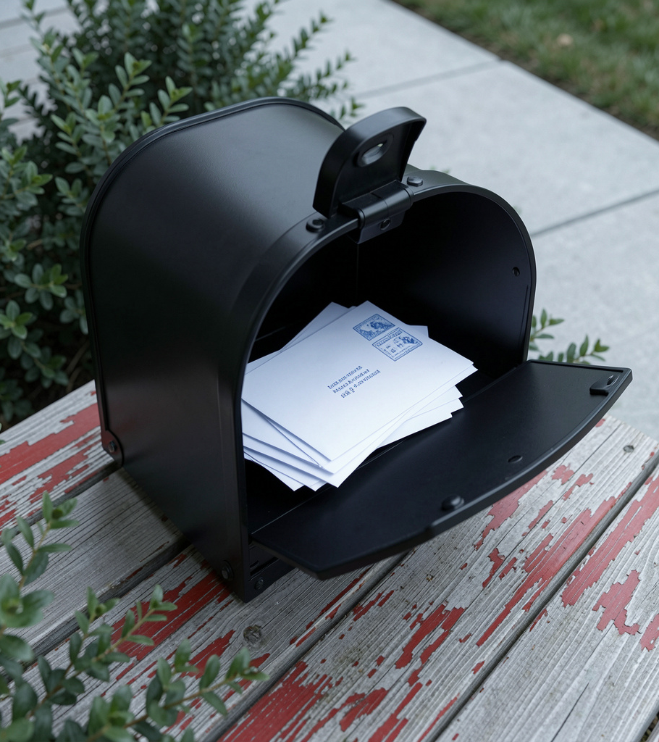
Objective
Build an email spam detection system.
Preprocess and clean email text.
Train a machine learning classifier.
Predict whether an email is spam or ham.
Improve email security through accurate classification and easy-to-use prediction.

Slide 5
Technologies Used
Python
Streamlit
Scikit-learn
Pandas
NumPy
NLTK
Pickle
These tools are used for data preprocessing, feature extraction, model training, and creating an interactive web application.

Slide 6
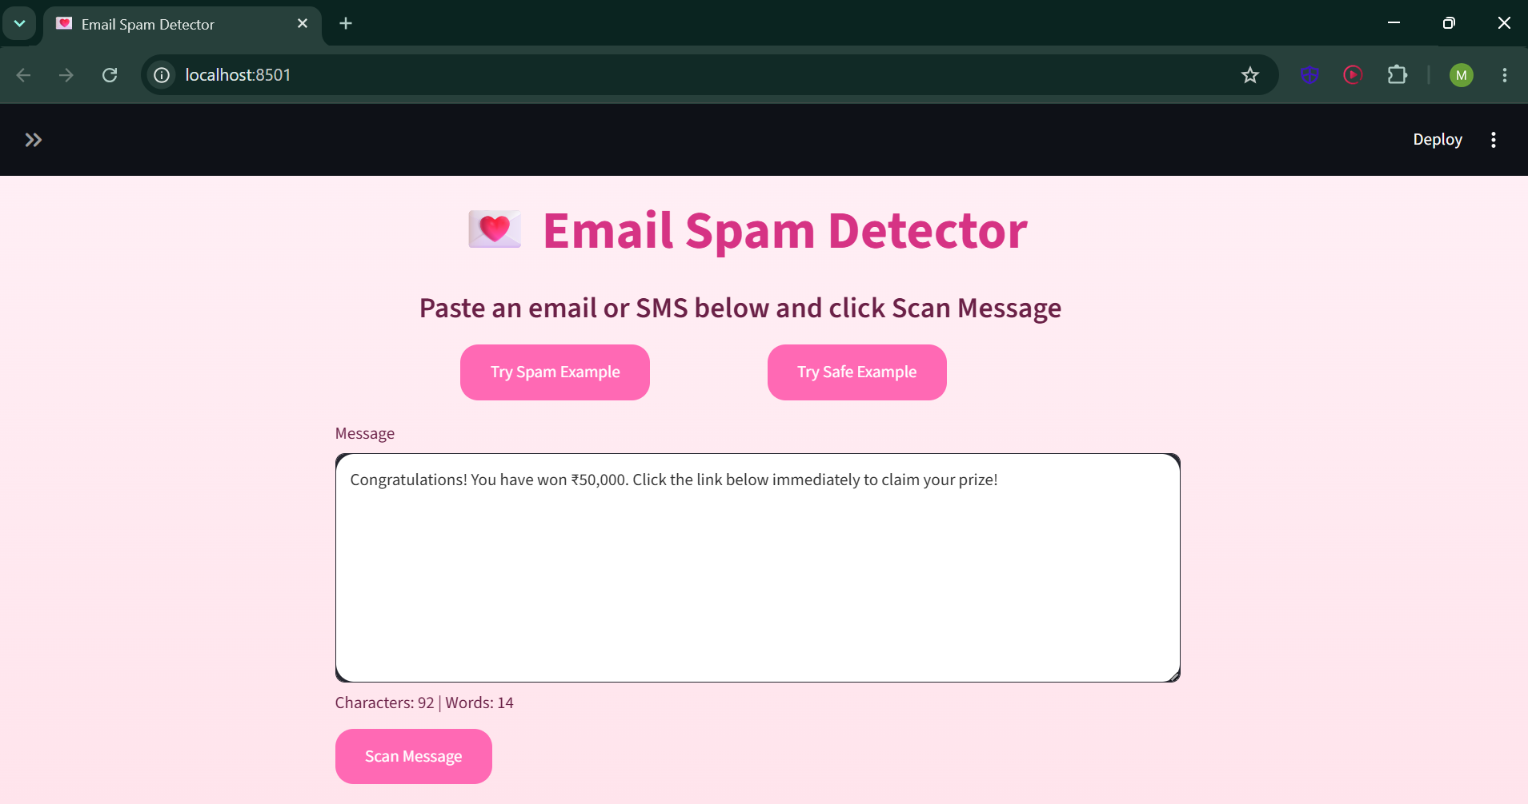
Working of the System
The user enters an email message into the application. The text is cleaned by removing punctuation and stop words. It is then converted into numerical features using TF-IDF. Finally, the trained machine learning model predicts whether the email is spam or ham.

Slide 7
Machine Learning Model
The project uses the Multinomial Naive Bayes algorithm because it performs well on text classification problems. The model is trained using labeled email data and learns patterns that distinguish spam messages from genuine emails, providing fast and accurate predictions.

Slide 8
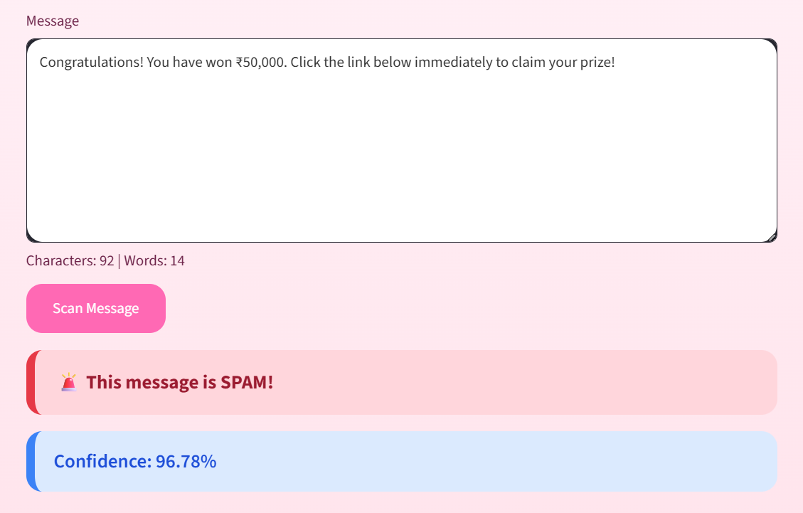
Features
User-friendly Streamlit interface
Instant spam prediction
Text preprocessing
TF-IDF feature extraction
Fast classification
High prediction accuracy
Lightweight and easy to deploy
Works with custom email input

Slide 9
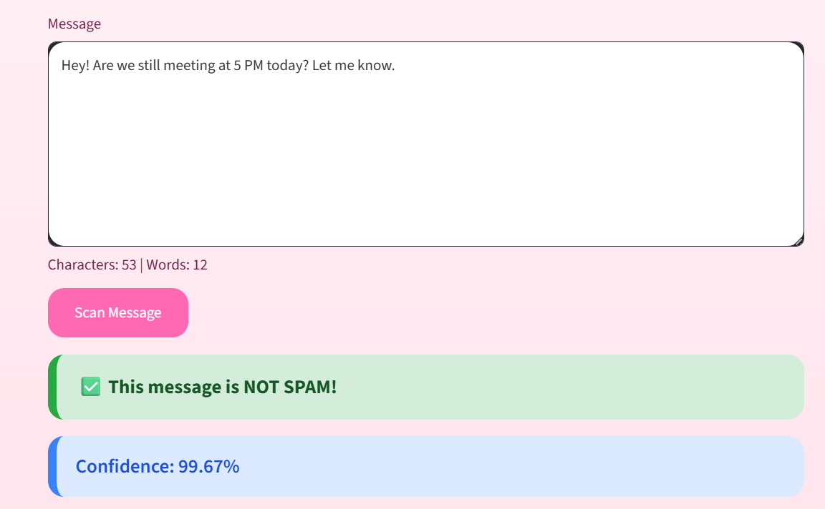
Advantages
Saves users' time.
Reduces unwanted emails.
Helps prevent phishing attacks.
Improves inbox organization.
Fast and efficient predictions.
Easy to use and maintain.
Can be updated with new training
data for better performance.

Slide 10
Future Scope
Future improvements include adding deep learning models, detecting phishing emails more accurately, supporting multiple languages, integrating with email platforms, and continuously retraining the model with new datasets to improve accuracy against evolving spam techniques.

Slide 11
Conclusion
The Email Spam Detector demonstrates how machine learning can automate email classification effectively. By combining text preprocessing, TF-IDF vectorization, and the Naive Bayes algorithm, the system accurately identifies spam messages. It provides a practical solution that enhances email security and improves the overall user experience.

